Slide 1


3 202S
Business Review
Performance, Progress
Priorities
Department / Project Name

Slide 2

Executive Summary: A Foundational QuaHer Setting the Stage for Q4 Acceleration
Q3 Performance Snapshot
D3 was a period of disciplined execution, marked by steady revenue growth and significant improvements in operational efficiency. We successfully delivered on the majority of our objectives, strengthening internal processes and client trust.
Strategic Implication
This focus on building a stable foundation in Q3 was deliberate. It has reinforced our execution capability and provides a solid platform from from which to scale our most successful initiatives and drive more ambitious outcomes.
Q4 Forward Look
Our Q4 plan is designed to leverage this momentum, focusing on measurable business impact, scaling what works, and launching key new projects.
G

Slide 3

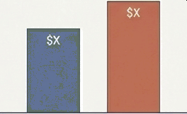


Q3 Performance Dashboard:
Revenue Performance
Total Revenue: $X QoQ Growth: +X'
Project Delivery
Customer Tat as Industrials
Total Revene: $X SLA Adherence: XP!
Delivered critical milestones on schedule, including the successful completion of Project A and Phase 1 of Project B.
Completion Rate
Quality & Reliability
quality Score: SLA Adherence:
Customer & Stakeholder Engagement
Q2 Q3
Start(e revenue growth was
Customer Satisfaction
achieved alongside disciplined
Process improvements led to higher quality
cost control, leading to a healthy
output, reducing rework and reinforcing
Consistent delivery and improved collaboration
net contribution of X%.
our reliability.
have strengthened client trust and ietentior.
G

Slide 4

Q3 Objectives vs. Reality: A Quarter of
Focused Execution
Planned Goals for Q3
Achieve targeted revenue / performance
benchmarks
Performance & Status
Achieved: Revenue targets met; operational costs controlled.
Improve overall productivity and output
Achieved: Productivity increased by X°z;
ality
Strengthen internal processes and workflows
pualitt Score reached X°z.
Achieved: Deployed process automation and
internal tool improvements.
Partially Met: Turnaround time reduced by XP, but some bottlenecks remain due to external dependencies. We have a mitigation plan for g4.
Achieved: Client satisfaction score bit X/10,
reflecting stronger engagement.
Reduce operational delays and inefficiencies
Improve stakeholder and client engagement

Slide 5
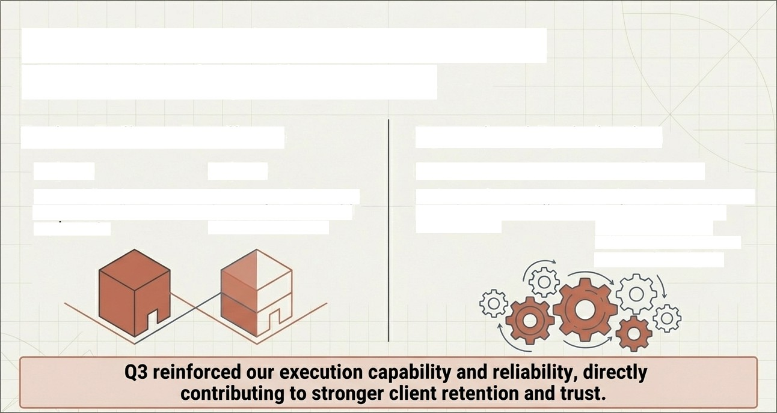
Delivering Critical Milestones and
Strengthening Client Trust
Project Delivery Excellence Operational Optimisation
Proje4 A Project B Process Automation Internal Systems
Successfully delivered on Phase 1 completed, setting Implemented new initiatives Deployed tool improvements
time, meeting all core the stage for a successful that reduced manual effort that have demonstrably
requirements. Phase 2 launch in g4. and error rates. improved cross-team
collaboration and reduced turnaround time by X°a.
G

Slide 6



Our Team: The Engine of Our Progress
Team Growth & Capability
Team Size: X members
New Additions: X new members onboarded
Upskilling: Conducted X targeted training sessions to enhance core competencies.
Performance & Productivity
Key Stat: Average productivity increase of X°4 this quarter.
This increase is a direct result of process improvements and enhanced task ownership across the team.
Culture & Coflaboration
Improved Communication
Better Task Ownership
Increased Cross-Functional Collaboration
A focused effort on our team culture has created a more engaged and adaptable unit, capable of tackling complex challenges.

Slide 7


Growth Pains & Key Learnings:
How We Are Adapting for Q4
Challenge Encountered in Q3 Our Learning & Strategic Adaptation
Resource Constraints: Faced shortages Learning: Early planning reduces execution risks.
during peak project delivery periods. Action: Implement more proactive risk identification and workload distribution for g4.
External Dependencies: Progress was
Learning: Clean communication improves delivery
impacted b/ delays from third-party partners.
speed.
_{n}A_{e}c_{w}tio_{u}n: M_{pr}a_{o}n_{je}d_{c}a_{t}t_{s}e. earlier stakeholder alignment on all
Scope Creep: Encountered changing
Learning: Continuous feedback improves outcomes. Action: Institute more frequent, structured check-ins for high-risk initiatives.
requirements mid project on several initiatives.
Technical Bottlenecks: Identified specific operational choke points in our workflow.
Learning: Automation saves time and reduces errors.
Action: Prioritise further automation ofidentified
bottlenecks in the 04 roadmap.

Slide 8

Our Q4 Blueprint: Leveraging Our Q3 Foundation to Accelerate Growth
Our 94 strategy is not about
starting over; it is about
Scale Success
Drive Efficiency
building upon the solid
operational and technical
foundation established in D3.
We will transition from a
mode of stabilisation
to one of deliberate acceleration.
The goal for g4 is clear: stronger growth with higher predictability.

Slide 9





Q4 Focus Areas and Measurable Targets
1. Scale Successful Initiatives
2. Drive Efficiency & Cost
Optimisation
Key KPI:
Revenue Growth
Target
Key KPI:
Productivity
Improvement
Target
3. Enhance Quality & Predictability
Key KPI: Quality Score
4. Launch for Impact
Tai-get > X
Key KPI:
Customer
Satisfaction
Tarqet
â X / 10
Key KPI: Delivery SLA
{tt|t Target a X%
G

Slide 10
Enablers for Q4 Success
To successfully execute our ambitious Q4 plan and deliver on our targets, we require continued partnership and support in the following areas:
We Need: Timely decision—making on key project gateways.
To Enable: Adherence to project
timelines and launch dates.
We Need: Clear priorities and a defined
scope for new initiatives.
To Enable: Efficient use of resources and prevention of scope creep.
We Need: Resource alignment for our
key prowth projects.
To Enable: The ability to scale successful initiatives as planned.
We Need: Continued leadership support for process changes.
To Enable: Lasting improvements in operational efficiency.

Slide 11





Translatlng Plans lnto Progress: Executlon AgalnSt Q3 Objectlves
Q3 Objective | Status & Key Result
Achieve targeted revenue / performance benchmarks | “ Achieved: Revenue grew +Xâ‹ QoQ.
Improve overall productivity and output quality Strengthen internal processes and workflows | Achieved: Productivity increased by X%; quality score maintained at X%. Achieved: Deployed process automation and internal system improvements.
Reduce operational delays and inefficiencies | Partially Met: Turnaround time reduced by XP though some external dependencies caused delays.
Improve stakeholder and client engagement | Achieved: Customer satisfaction score of X/10 and strengthened client retention.
We successfully met the majority of our objectives, with partial results on one goal due to external constraints that are now being actively managed.

Slide 12


Deliverlng on Our Promises: Key Project and Operatlonal Wins
Crltical Milestones Delivered
Project A
Successfully delivered on time, meeting all key requirements and strengthening client trust.
Project B
Phase 1 completed on schedule, setting the stage for the next phase of development.
Foundational Process Improvements
Process Automation
Implemented new automation initiatives, which contributed to a reduction in manual errors.
System Enhancements
Deployed significant improvements to internal tools, boosting team productivity.
Turnaround Time
Systematically reduced average task turnaround time by X% through workflow optimisation.

Slide 13



The Engine Behind Our Success:
Team Growth and Productivity
The Result
Team Investment
Team Size: X members
New Additions: X new team
members onboarded
Upskilling: X training sessions conducted
Cultural Health
Observed improvements in cross-functional collaboration, clear task ownership, and proactive communication.
Average productivity increase this quarter, directly linked to team upskilling and improved
engagement.

Slide 14
Growth Pains and Key Learnings: How We Are Adapting for the Future
Challenge Encountered |  | What We Learned & How We Will Adapt
Resource constraints during peak project periods. |  | Learning: Better workload distribution is critical. Action: Implement more rigorous capacity planning for Q4.
External dependencies and partner delays impacting timelines. |  | Learning: Early and continuous communication is key. Action: Schedule earlier alignment meetings with stakeholders.
Technical bottlenecks discovered late in the development cycle. |  | Learning: Automation saves time and reduces errors. Action: Continue to invest in process automation.
Changing requirements and scope creep post-kickoff. |  | Learning: Early risk identification is non-negotiable. Action: Institute more proactive risk identification workshops at the start of all new projects.

Slide 15
Our Q4 Blueprint: Leveraging Our Foundation to Accelerate Growth
To achieve stronger growth with higher predictability by building on Q3’s successes.
Scale Success Identify and scale the most successful
process improvements from O3.
Drive Efficiency
Deepen our focus
OFF COSt
optimisation and operational efficiency to impro've margins.
Strengthen Quality
Implement enhanced quality control and monitoring systems
to ensure excellence.
Launch New Value Begin work on new strategic projects and features designed to deliver measu ab e
business impact.
G

Slide 16





Our Key Targets and Commitments
Defining Success in Q4:
Revenue
Growth
Productivity
Improvement
Quality
Score
a
Delivery SLA
Compliance
a
Customer Satisfaction
a 10
These targets represent a de/iberate step-up frOm Q3 perfOrmance, reflecting
our confidence in the foundational improvements we have made.

Slide 17






Enablers Q4 Success
To achieve our ambitious Q4 goals, we require the following partnership and support:
Timely
Decision-Making
To ensure our new projects can launch on schedule and maintain momentum.
Strategic Resource
Alignment
To support the scaling of successful Q3 initiatives without impacting core impacting core delivery.
Continued Leadership Support
To help navigate external dependencies and unblock cross- departmental hurdles.
Clear Priority and
Scope Definition
To prevent scope creep and ensure the team remains focused on delivering maximum business impact.

Slide 18



Poised for Stronger 94
Q3 was a productive and learning-driven quarter where we established a strong base for future growth.
„„r' The team demonstrated commitment and adaptability, successfully
^d“ delivering on key objectives while navigating challenges.
We have a clear, targeted roadmap for Q4 that builds directly on our momentum.
V
With continued focus and collaboration, we are well-positioned to achieve even stronger results in the coming quarter.

Slide 19

Q3 in Review
. A Productive Foundation: Q3 was a productive and learning-driven quarter where we successfully established a strong base for future growth.

