Slide 1
[Organisation Name}
Project Kickoff

Slide 2
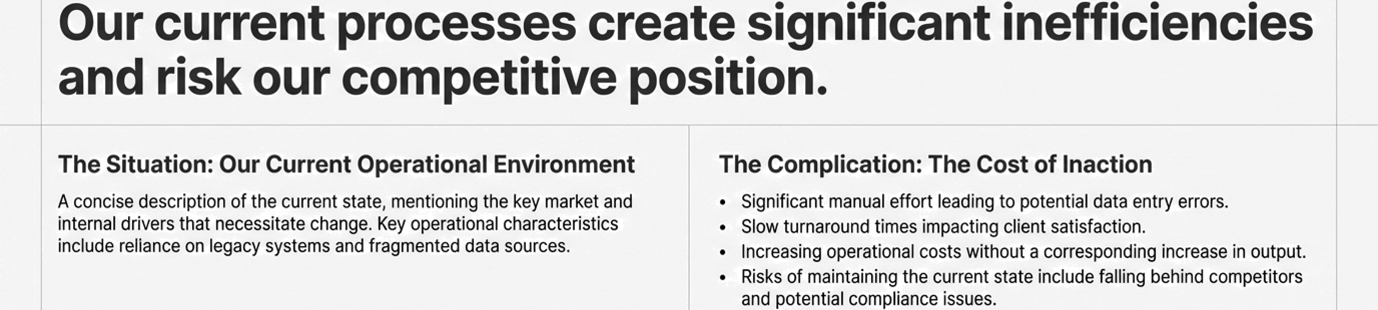

Our current processes create significant inefficiencies and risk our competitive position.
The Situation: Our Current Operational Environment
A concise description of the current state, mentioning the key market and imernal drivers that necessitate changa. Key operational characteristics include reliance on legacy systems and fragmented data sources.
The Complication: The Cost of Inaction
Significant manual effort leading to potential data entry errors.
Slow turnaround times impacting client satisfaction.
Increasing operational costs without a corrasponding increase in output.
Risks of maintaining the current state include falling behind competkors
and potential compllance issues.
Ideal Process Flow
Wasted Hours
Oata Errors
Client Satisfaction

Slide 3
Project Overview
Next Step | Owner | Due Date
Confirm Scope & Objectives | Project Manager & Business Leads | Date + 1 Week]
Finalise Detailed Project Plan | Project Manager | [Date + 2 Weeks]
Assign Detailed Responsibilities to Team | All Leads | [Date + 2 Weeks]
Schedule Phase 1 Workshops | Project Manager | [Date + 2 Weeks]

Slide 4


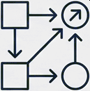
We envision a future where our operations are
automated, efficient, and user-centric.
Core Vision Statement: Project Alpha will transform our operational backbone, creating a seamless, intelligent, and scalable platform for future growth.
Value to the Business
Dramatically improve operational perforrriance, reduce processing costs, and directly support our strategic goals for market leadership.
Value to Users
Enhance the daily experience of our teams, eliminating manual toil and empowering a focus on high-value, client-facing work.
Sustainability & Scalability
Build a future-proof solution designed for long-term growth, adaptable to evolving business needs and technological advancements.
G NotebookLM

Slide 5





Project Alpha is our strategic initiative to modernise and
automate our core operational workflows.
This project will redesign and implement a new, streamlined system for our end-to-end operational processes. It replaces manual data entry and fragmented workflows with a single, integrated platform designed for speed, accuracy, and user efficiency.
Automation
Targeting key manual processes
for end-to-end automation.
Performance Systematically improving the speed and quality of outputs.
User Experience
Designing a more intuitive and
efficient system for our internal teams.
Expected Impact
A measurable reduction in cost and effort.
A significant improvement in data accuracy and process reliability.
An enhanced ability to serve our clients effectively.
G Nc•tebookLM

Slide 6




We will achieve our vision through four clearand measurable objectives.
1. Automate Key
Processes
Reduce manual intervention in the end-to-end invoicing process by by Q4.
2. Improve Performance & Quality
Increase data processing accuracy to , measured through
post-deployment audits.
3. Reduce Cost &
Effort
Lower the operational cost per transaction by within six months OI go-live.
4. Enhance User Experience
Achieve a user satisfaction
score of or higher from key business users pOst training.
G NotebookLM

Slide 7


Defining our focus: What is in and out of
scope for Project Alpha.
IN SCOPE
Requirements Gathering
Solution Design
Development & Integration
Testing & Deployment
User Documentation & Training
OUT OF SCOPE
Replacement of adjacent legacy platforms
Major corporate infrastructure upgrades
Long-term maintenance & support
beyond the initial handover period
Unplanned feature expansions outside the agreed requirements
This focus ensures we deliver core business value on time and on budget.
G NotebookLM

Slide 8




Our work will result in five key deliverables that ensure a successful implementation and handover.
An Approved Project Plan: To provide a clear roadmap and single source of truth for
execution.
‹/›
A Fully Functional Solution: To meet the defined business requirements and Objectives.
Comprehensive Test & Validation Reports: To guarantee quality, reliability, and security.
User Guides & Training Materials: To ensure seamless adoption and long-term user
success.
Final Handover Documents: To enable a smooth transition to the business-as-usual
support teams.
G NotebookLM

Slide 9





Our delivery is structured in five disticct phases with clear milestones.
User Acceptance Testing (UAT) Complete
Project Kickoff (Today)
Design
Sign-Off
Development
Complete
Production
Go-Live
Phase 1:
Planning
Phase 2: Design
Phase 3: Development
Phase 4: Testing
Phase 5:
Go-Live & Handover

Slide 10



Meet the core team responsible for delivering Project Alpha.
Project Sponsor: [Name, Title] ”Responsibility: Provides strategic oversight, champions the
project, and removes high-level obstacles.”
Steering Committee: [List of key
members/departmentsJ
*Responsibility: Governs the project, providing
guidance and key decisions at major milestones.^
Project Manager: [Name, Title] ”Responsibility: Manages the day-to-day delivery,
coordination, and communication.”
Core Project Team / Leads: [Names/Functions, e.g., Tech Lead, Business Analyst]
‘Responsibility: Responsible for the technical and functional execution of the project.*
Key Business Users:
[Names/Departments]
’Responsibility: Provide critical input, validate the
solution, and champion adoption.*
G NotebookLM

Slide 11
We will ensure predictable delivery through a robust governance framework.
Communication Cadence
Weekly Status Meetings & Progress Reports (for the Core Team).
Monthly Steering Committee Updates (for key decisions).
A defined Escalation Process for resolving issues promptly.
Risk & Issue Management
Proactive identification of risks (e.g., Schedule Delays, Scope Creep, Resource Constraints).
Clear mitigation strategies including rigorous scope management, regular progress tracking, and continuous stakeholder engagement.
Change Management
A formal Change Request process to assess the impact of any proposed changes.
A defined Approval Workflow involving relevant stakeholders.
G NotebookLM

Slide 12
Our plan is grounded in a clear understanding of our assumptions and constraints.
Key Assumptions
Critical business and IT resources will be
available as planned.
Stakeholder feedback will be provided in a timely manner at key decision points.
Core business requirements will remain stable throughout the development phase.
Key supporting systems and platforms will remain available and stable.
Project Constraints
Timeline: A fixed go-live date that we must adhere to.
Budget: A defined budget that dictates the scope of work.
Resources: Specific limitations on the availability of key personnel.
Compliance: Adherence to all relevant regulatory and compliance requirements.
G NotebookLM

Slide 13



Our immediate focus is on finalising the plan and beginning execution.
Next Step | Owner | Due Date
Confirm Scope & Objectives | Project Manager & Business Leads | Date + 1 Week]
Finalise Detailed Project Plan | Project Manager | [Date + 2 Weeks]
Assign Detailed Responsibilities to Team | All Leads | [Date + 2 Weeks]
Schedule Phase 1 Workshops | Project Manager | [Date + 2 Weeks]
We look forward to partnering with all of you
to make Project Alpha a success.
G NotebookLM

Slide 14





Project Alpha: Key Contacts Information Hub
For Strategic Enquiries: Project Sponsor Name Project Sponsor
email@nusacr@gmaiI.com
Project Information Hub
Visit our project hub for the latest updates, documents, and meeting schedules.
Project Manager Name
Project Manager
email@namexample.com (900) 556 7893

